Slide 1

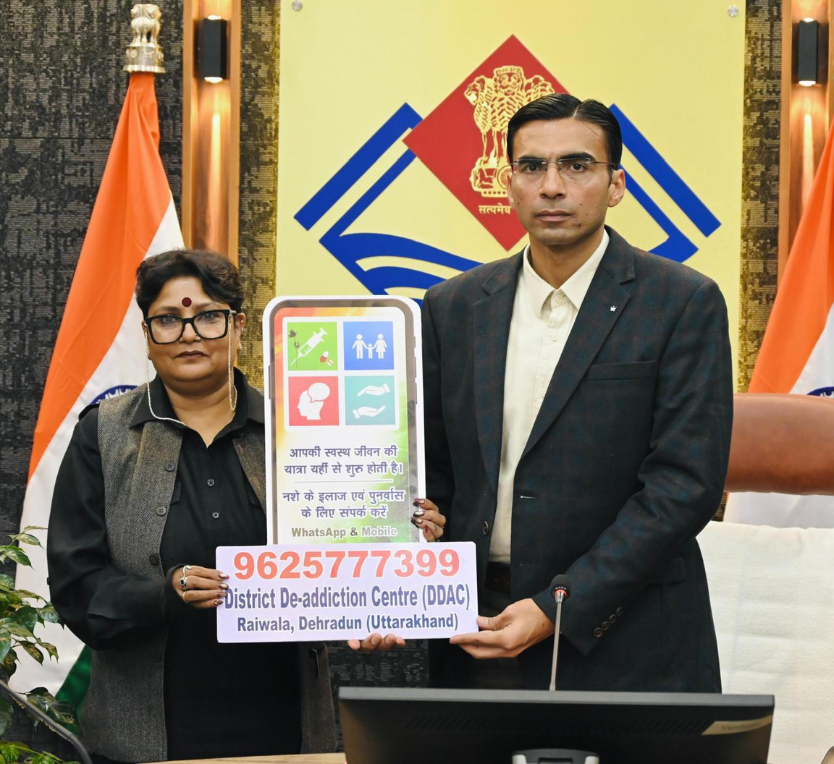
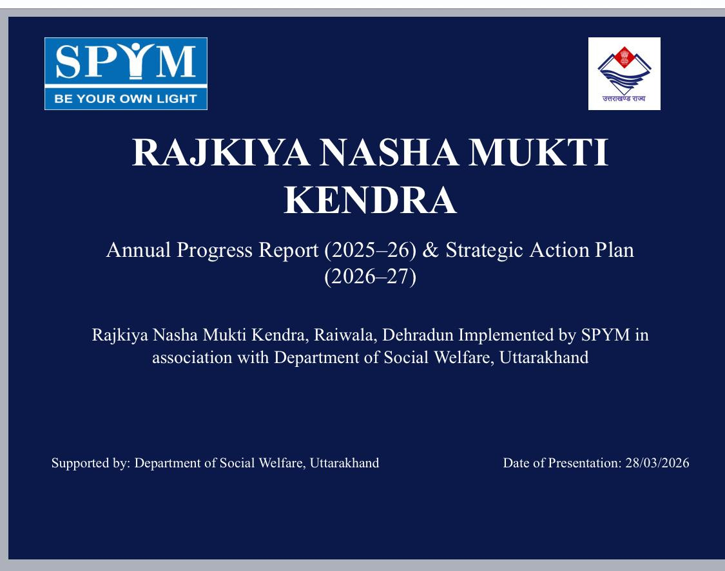

Rajkiya Nasha Mukti Kendra
Annual Progress Report (2025–26) &
Strategic Action Plan (2026–27)
Building a Drug-Free Uttarakhand Through Holistic Healing and Educational Intervention
DM Dehradun Mr. Savin Bansal launched Helpline number
Supported by:
Department of Social Welfare, Uttarakhand
Date of Presentation: 28/03/2026

Slide 2
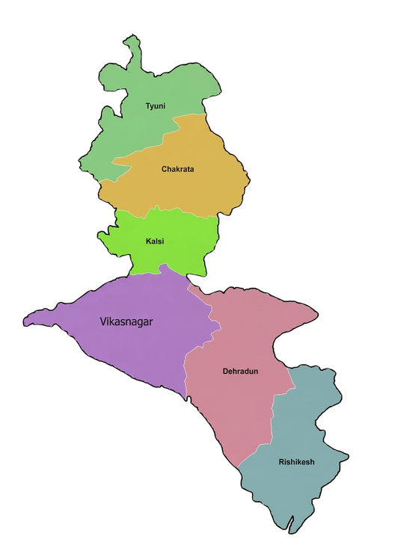
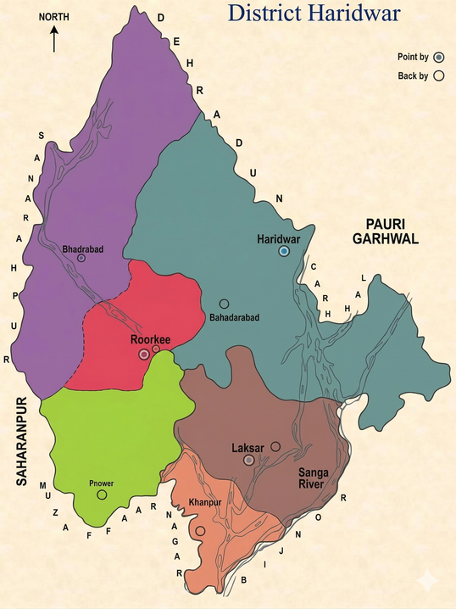
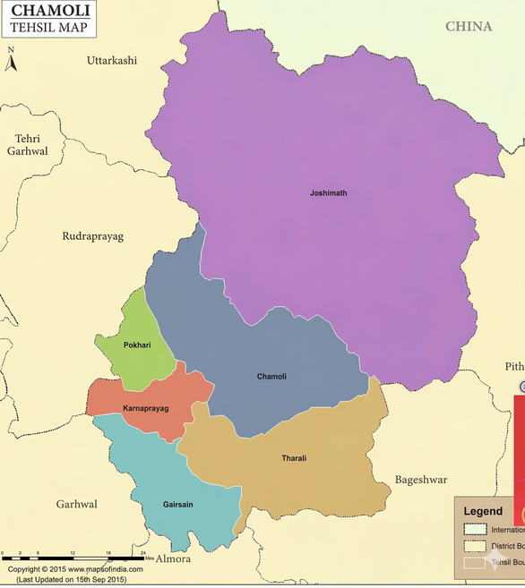
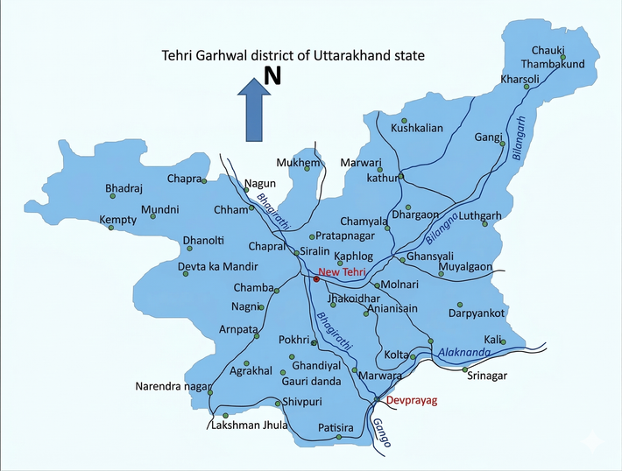
Project Overview & Geographic Scope
Our comprehensive rehabilitation and awareness program , span into four key districts across Uttarakhand, reaching communities most affected by substance abuse.
Focus Districts
Dehradun (Headquarters)
Haridwar
Tehri Garhwal
Chamoli
Implemented by: SPYM in association with Department of Social Welfare, Uttarakhand

Slide 3

Our Mission
"To ensure holistic healing combined with educational intervention for a resilient society."
Rehabilitation
Comprehensive care and rehabilitation services for male adults aimed at recovery and successful reintegration into society.
Awareness
Community-wide substance use awareness campaigns targeting schools, colleges, and youth populations.

Slide 4
A Year of Exceptional Reach
Impact Report 2025–26
100%
IMPACT
125%
CAPACITY
COVERAGE
CERTIFIED
Center running beyond full capacity as of March 2026 due to high demand and trust.
All Government Senior Secondary Schools in Dehradun District reached with awareness programs.
Participation certiﬁcates issued to students to encourage long-term advocacy.
The consistent rise in intake reﬂects growing community trust and demonstrates the critical need for our services.

Slide 5

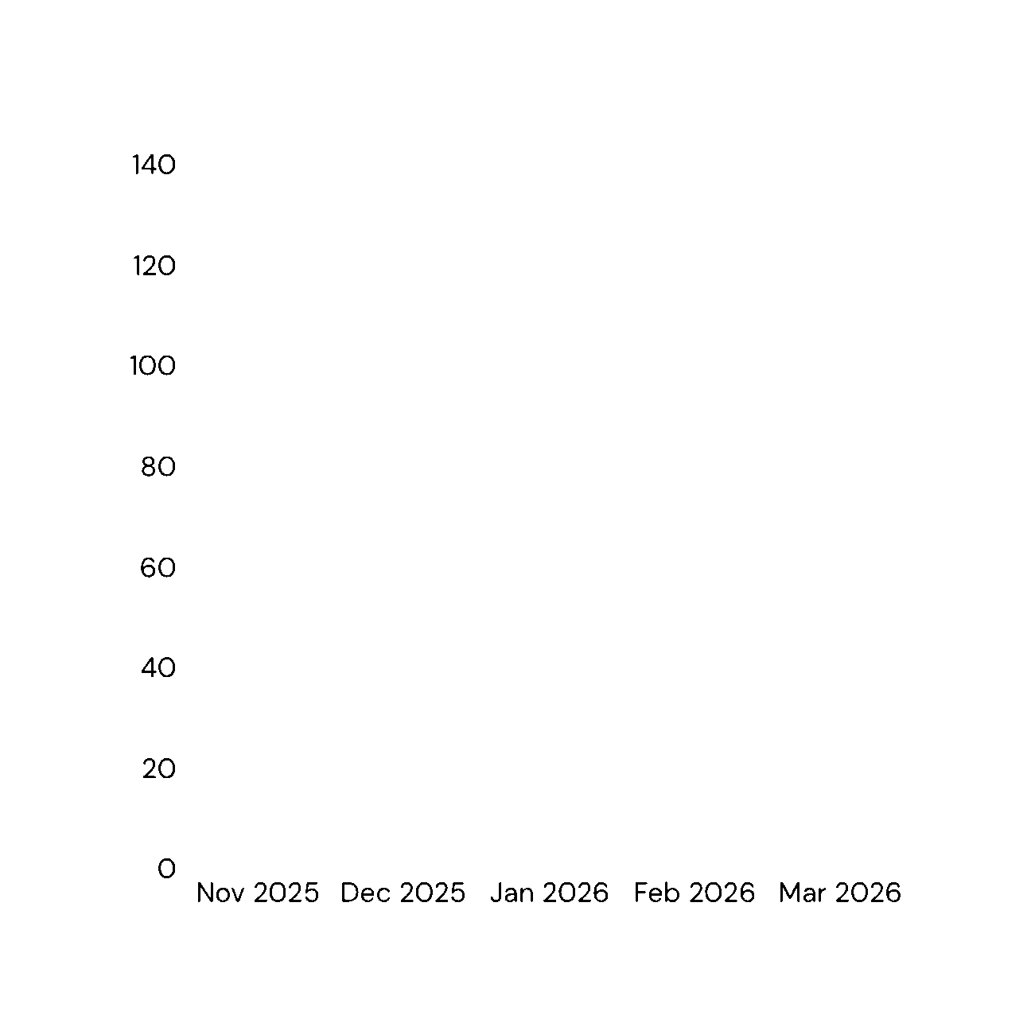

Capacity Growth Trend
November 2025-March 2026
Growth Factor
Consistent rise in intake
Status : Over-Subscribed
The center has transitioned to an over-subscribed status, demonstrating consistent growth in intake and increasing demand for our comprehensive rehabilitation services.

Slide 6




The Rehab Model: Beyond Clinical Support
Holistic Healing Approach
Counseling
Regular individual and collective sessions focusing on mental resilience, emotional regulation, and long-term behavioral change strategies.
Eco-Therapy
High engagement in gardening and outdoor tasks to
foster responsibility, physical health, and connection with nature.
Physical Health
Community Building
Structured focus on daily routines, balanced nutrition, and mental wellness for complete recovery and sustainable lifestyle changes.
Interactive sessions with AA and NA volunteers to build lasting support networks and peer connections.

Slide 7
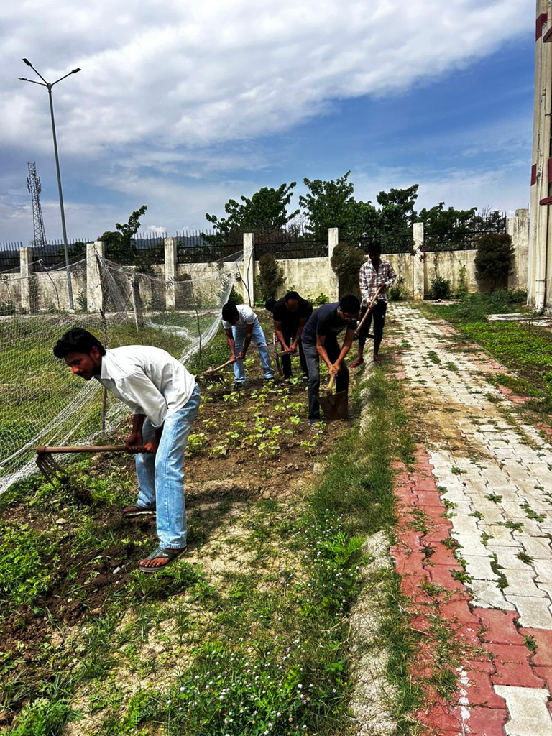
Eco-Therapy in Practice
Holistic Healing Through Nature
Residents engage in daily nature-based activities including gardening, outdoor maintenance, and teamwork exercises. These activities foster responsibility, improve physical health, and strengthen community bonds.

Slide 8

The Road Ahead: Quality & Life Skills
Action Plan 2026–27
Life-Skills Based Programs
Moving from"Sobriety" to"Employability" by equipping residents with vocational training and essential soft skills
for sustainable livelihoods.
Wellness Integration
Daily mindfulness, meditation, and yoga sessions integrated into the core curriculum to promote a healthy,
balanced lifestyle.
Expanded Outreach
Taking awareness programs beyond schools to private institutions and colleges to broaden community impact.

Slide 9

Strategic Outlook
Our Vision for the Future
"To create a resilient society where every individual has the skills to choose a healthy, substance-free life."
Operational Goal
Maintain 100% capacity utilization with uncompromising quality care standards across all programs.
Strategic Expansion
Continue scaling awareness programs while enhancing vocational training and community integration services.

Slide 10
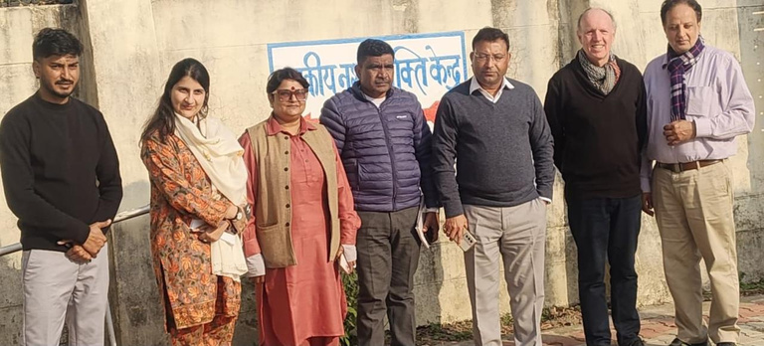
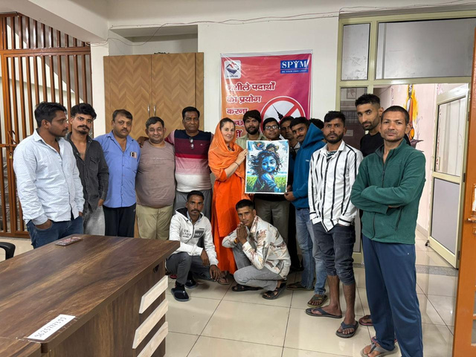
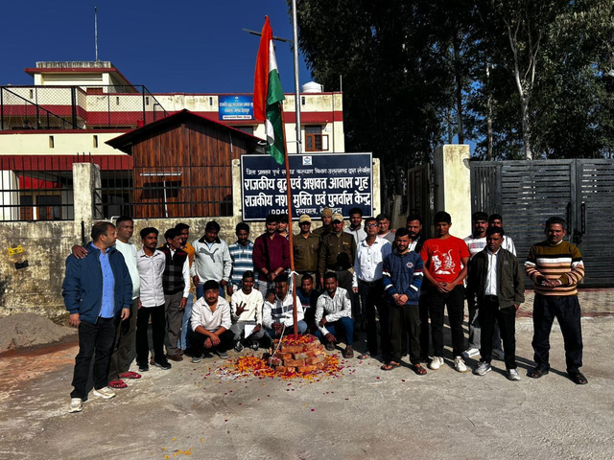
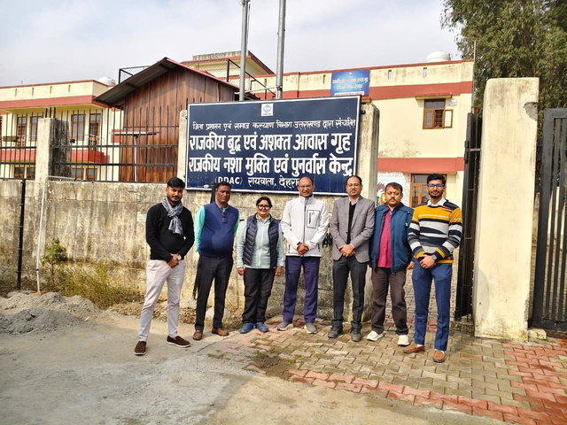
Gallery
Mr Prakash Chandra
IAS additional secretary Uttrakhand government social welfare department
Mr Gary Reid
international expert UN official
MS . Aayushi
consultant Uttarakhand government social welfare department
Sadhvi Triambakeshwari from Germany visited the centre
Republic Day Celebration
Visit for Health check up- doctors of AIIMS Rishikesh

Slide 11
Our Vision for the Future
"To create a resilient society where every individual has the skills to choose a healthy, substance-free life."
Visit Us: Rajkiya Nasha Mukti Kendra Raiwala, Dehradun
Phone: +91 9625777399 Email: dc-dehradun@spym.org Partners: Department of Social Welfare, Uttarakhand
SYPM - Annual Progress Report 2025-26
Together, we're building a drug-free Uttarakhand—One day at a time.

